Slide 1
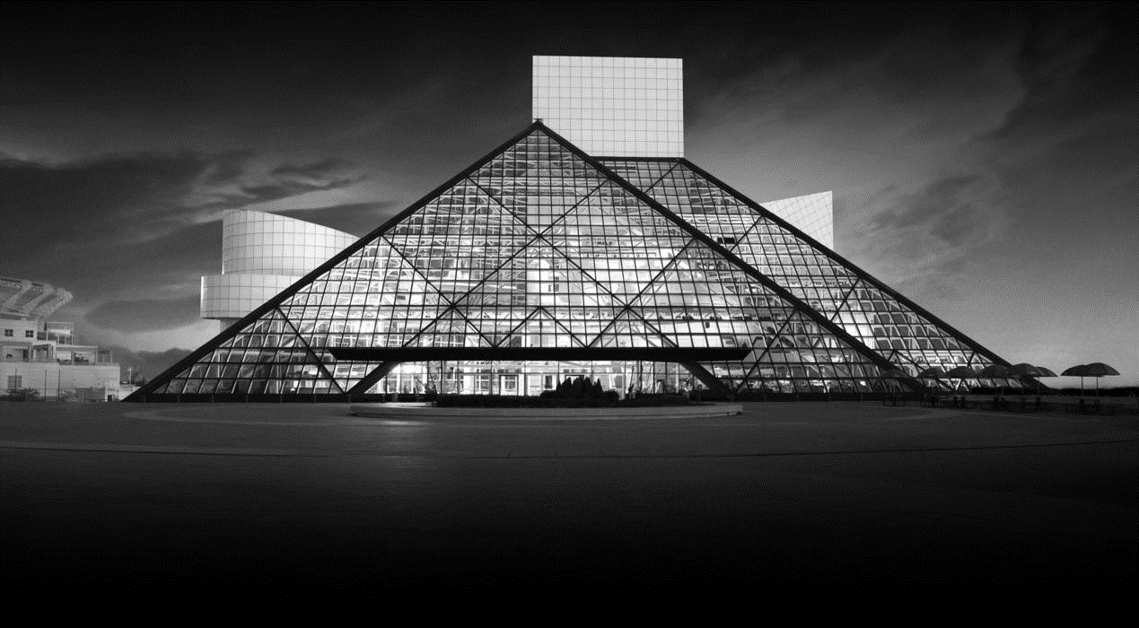
PREDICTING THE ROCK AND ROLL HALL OF FAME Grayson Bates, Michael Borenstein and Andrew Malanowski

Slide 2

HALL OF FAME?
“Writing about music is like dancing about architecture.”
– attributed to various sources
Unlike a sports hall of fame, where you can cite statistics like home runs or sacks, how do you qualify musical artists for induction? Can statistical analysis be applied?

Slide 3
BACKGROUND
Founded in 1983 by Atlantic Records founder Ahmet Ertegun, Rolling Stone founder Jann Wenner, longtime Bruce Springsteen manager Jon Landau and a small group of music executives, managers and attorneys.
214 artists have been inducted as performers since annual inductions began in 1986.
The nominating committee, chaired by Landau, currently consists of 29 members, and nominates 15 artists each year.
Ballots are then sent to 600 “rock experts.” Artists with the highest number of votes and more than 50% of the vote are inducted. Number of inductees varies.

Slide 4
THE “CRITERIA”
The only real qualification for nomination is that it has been 25 years since the artist’s first record was released. Criteria include “the influence and significance of the artists' contributions to the development and perpetuation of rock and roll”.
Definition of rock and roll is very flexible, therefore we did not include genre as a determining factor in this exercise. Initial nominees were early rock and roll, doo-wop, Motown stars. Expanded to classic rock, and over the years to pop/dance music (Michael Jackson, Madonna), heavy metal (Black Sabbath, Metallica), jazz (Miles Davis), country (Johnny Cash) and even rap (Public Enemy, Run-DMC, 2Pac).

Slide 5
OUR CRITERIA
We looked at 145 passed-over artists in addition to 214 inductees (359 total):
Number of hit singles (Billboard Hot 100, US)
Total album sales (RIAA certified, US)
Average streaming listens per month (Spotify, global)
Average album rating, 0-5 stars (All Music Guide/allmusic.com)
Influence over other artists (All Music, number of followers listed on artist’s page)
Number of albums listed in the Top 500 Albums of All-Time (Rolling Stone magazine)
Appearances on the cover of Rolling Stone magazine

Slide 6
ALGORITHMS USED TO EXPLORE OUR DATA
Logistic Regression
Decision Trees
Random Forest
Support Vector Machines
Naïve Bayes

Slide 7
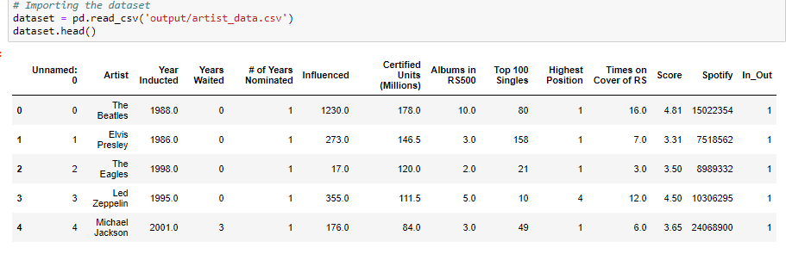

Slide 8
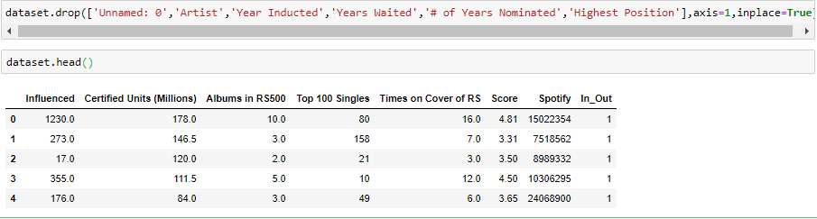

Slide 9
Code Template:
# Importing the libraries
import numpy as np
import matplotlib.pyplot as plt
import pandas as pd
# Importing the dataset
dataset = pd.read_csv(‘Example.csv')
X = dataset.iloc[:, [specific column indexes here]].values
y = dataset.iloc[:, specific column index here].values
# Splitting the dataset into the Training set and Test set
from sklearn.cross_validation import train_test_split
X_train, X_test, y_train, y_test = train_test_split(X, y, test_size = 0.30, random_state = 0)
# Feature Scaling
from sklearn.preprocessing import StandardScaler
sc = StandardScaler()
X_train = sc.fit_transform(X_train)
X_test = sc.transform(X_test)

Slide 10
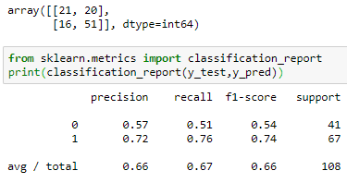
Support Vector Machines
66% precision
72 correct predictions
36 incorrect predictions
Conclusion: We need a better model!

Slide 11
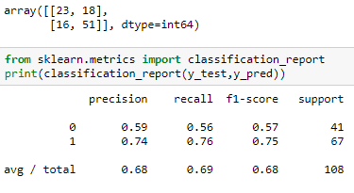
Logistic Regression
68% precision
74 correct predictions
34 incorrect predictions
A decent score, but we still wanted a better performing algorithm!

Slide 12
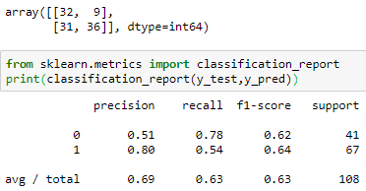
Naive Bayes
Precision of 69%
68 correct predictions
40 incorrect predictions
Getting there, but we wanted our model to at least get us into the 70s.

Slide 13
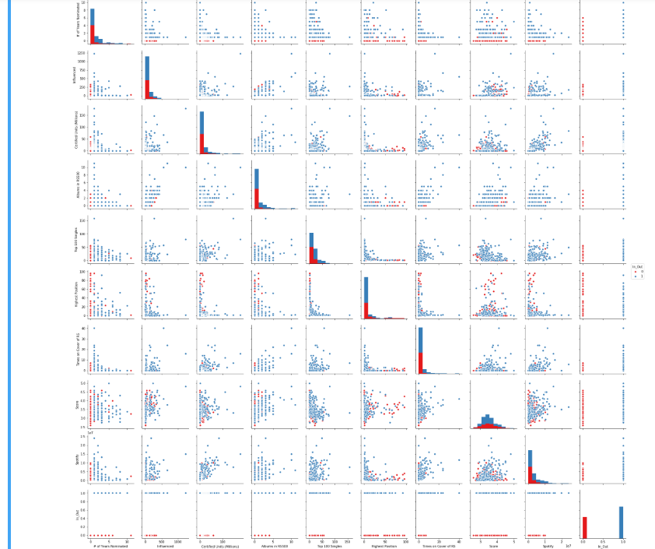

Slide 14
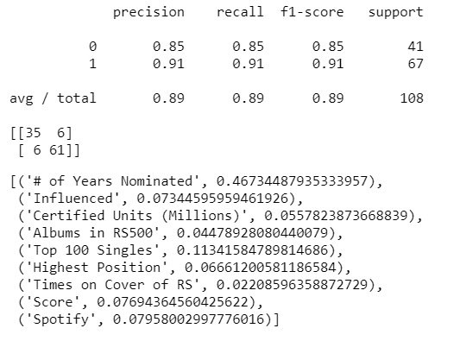
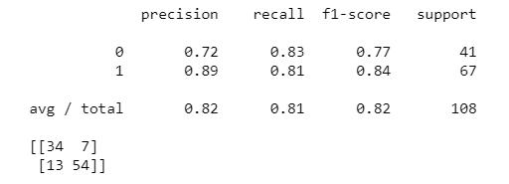
Optimizing Our Chosen Model…
Too good to be true?

Slide 15
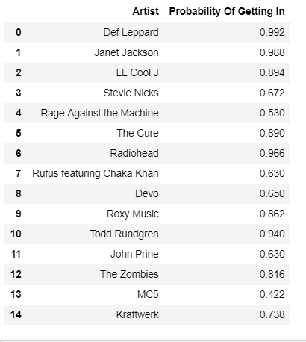
Too much confidence

Slide 16
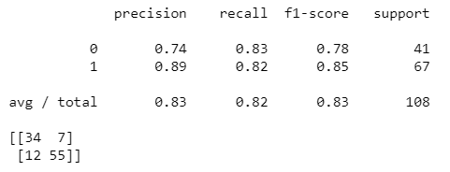
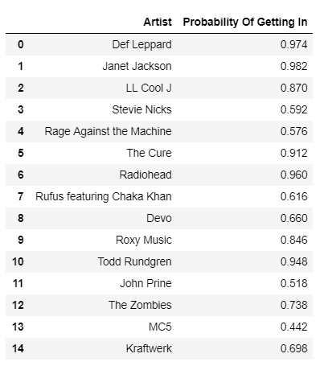
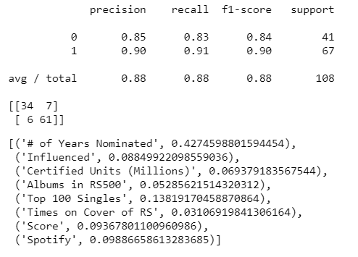
# of Years Nominated

Slide 17
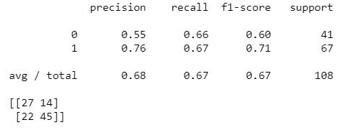
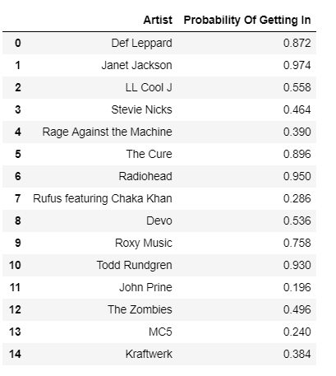
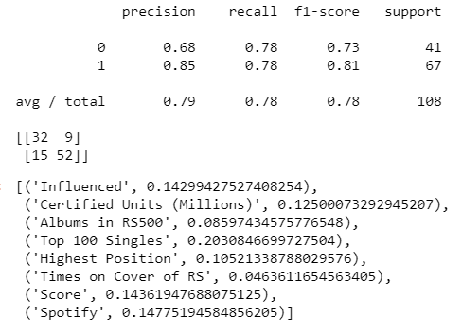
Highest Position

Slide 18
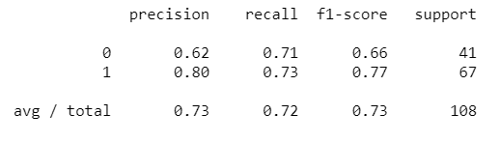
Decision Tree

Slide 19
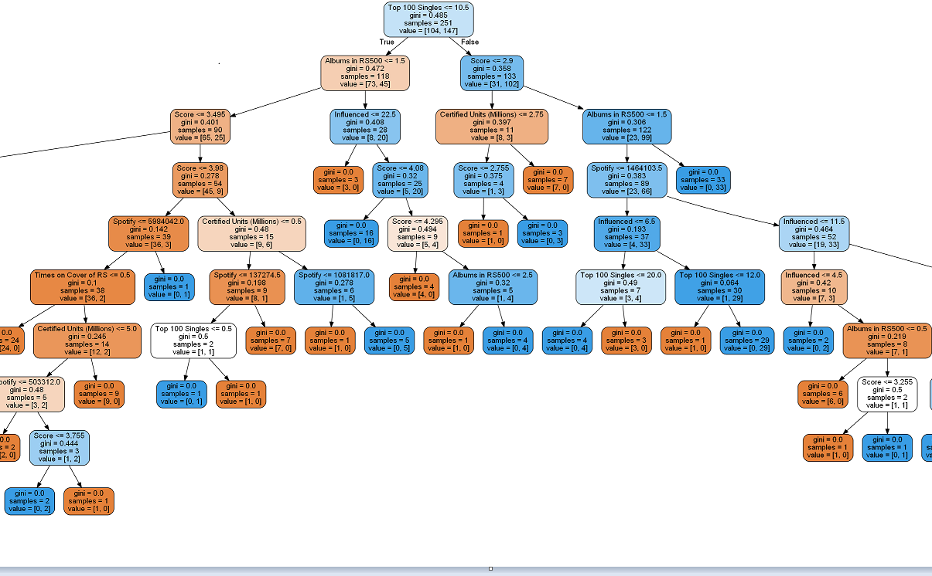

Slide 20
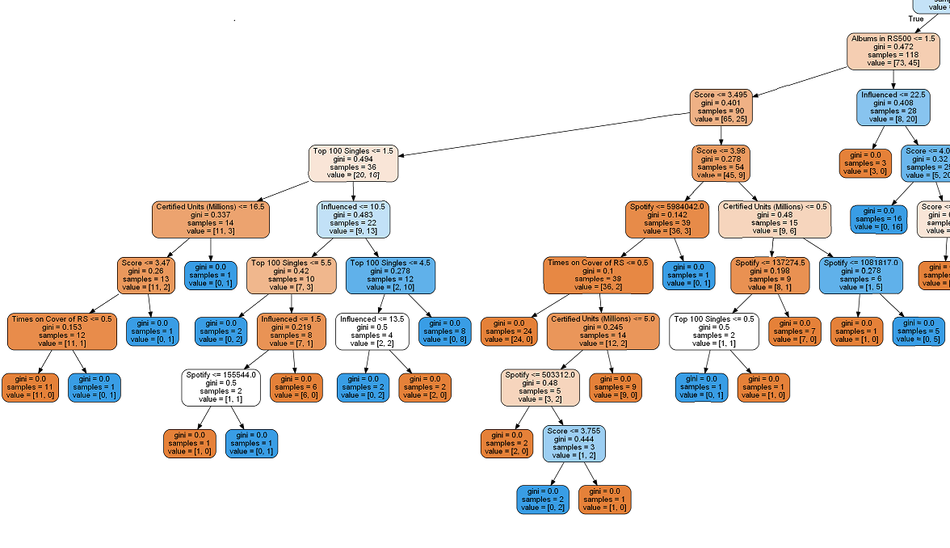

Slide 21
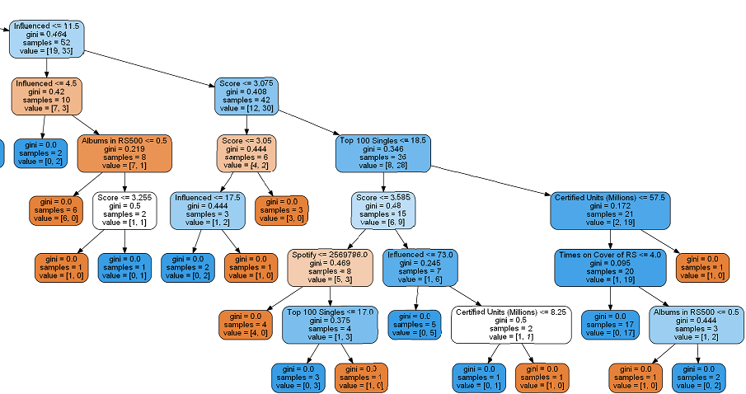

Slide 22
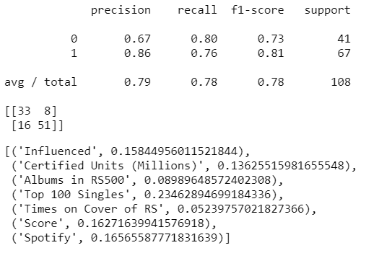
Random Forest
Optimized

Slide 23
2019 NOMINEES
Def Leppard
Devo
Janet Jackson
John Prine
Kraftwerk
LL Cool J
MC5
Radiohead
Rage Against the Machine
Roxy Music
Rufus feat. Chaka Khan
Stevie Nicks
The Cure
The Zombies
Todd Rundgren

Slide 24
2019 PREDICTIONS
Mike’s Picks
Def Leppard
Devo
Radiohead
Janet Jackson
Kraftwerk
Billboard Picks
Radiohead (Even)
Stevie Nicks (3 to 2)
Janet Jackson (2 to 1)
The Zombies (2 to 1)
Def Leppard (5 to 2)
Model Picks
Janet Jackson (95.8%)
Radiohead (93.4%)
Todd Rundgren (89.4%)
Def Leppard (87.8%)
The Cure (87.6%)

Slide 25
CLASS OF 2044?
Adele
Ariana Grande
Beyonce
Bruno Mars
Calvin Harris
Cardi B
Coldplay
DJ Khaled
Drake
Ed Sheeran
Eminem
Imagine Dragons
Justin Bieber
Justin Timberlake
Kanye West
Kendrick Lamar
Lady Gaga
Lil Wayne
Maroon 5
Nicki Minaj
Rihanna
Taylor Swift
The Chainsmokers
The Weeknd
Twenty-One Pilots

Slide 26
2044 PREDICTIONS
Eminem (94.4%)
Kanye West (89.8%)
Drake (78.2%)
Rihanna (69.4%)
Lil Wayne (63.8%)

Slide 27

THANK YOU! GOOD NIGHT!!!

